Slide 1

Human Activity Recognition
Using ConvLSTM & LRCN
UCF50 Dataset | Akash Rana | April 2025
Notes:
Today, I’ll walk you through our project on Human Activity Recognition, using two deep learning models — ConvLSTM and LRCN — applied to video data from the UCF50 dataset.

Slide 2
Agenda
Project Motivation & Problem Statement
Dataset & Pre‑processing
Methodology Overview
Model Architectures: ConvLSTM vs LRCN
Training Configuration
Evaluation & Results
Comparative Insights
Conclusion & Future Work
Notes:
Here’s what we’ll cover today: We’ll start with the motivation behind this work, move into the dataset and preprocessing, then review our methodology, architectures, training process, evaluation results, and finally, draw conclusions and talk about what’s next.

Slide 3

Why Human Activity Recognition (HAR)?
Key to surveillance, healthcare monitoring, and HCI.
Need models that capture both spatial and temporal cues in video.
Goal: classify complex activities in untrimmed clips efficiently.
Notes:
Why Human Activity Recognition (HAR)?
Recognizing human activities is crucial in many real-world applications like surveillance, healthcare monitoring, and human-computer interaction.
By understanding what a person is doing, systems can respond more intelligently — whether it’s detecting a fall in an elderly care home, spotting unusual behavior in a security feed, or enabling more natural interactions with smart devices.
Traditional computer vision models, which mainly analyze single images, fall short when it comes to recognizing activities.
An isolated image can tell us what objects are present, but it doesn’t capture how a person is moving or how the scene evolves over time.
Activities are inherently dynamic — it’s not just about what appears in a frame, but how that appearance changes across a sequence.
To truly recognize human actions, we need models that combine spatial understanding (what is happening in each frame) with temporal understanding (how the frames connect over time).
This is why approaches like ConvLSTM and LRCN are important — they are designed to model both space and time, allowing deeper interpretation of human behavior in video data.

Slide 4
Broader Impact: Predictive Movement Modeling
HAR outputs serve as inputs for HMM/DBN-based movement prediction.
Towards proactive smart home automation: predicting future user actions.
Synergy between deep learning (HAR) and probabilistic models (HMM, DBN).
Enhances user-centric experiences through intelligent automation.
Notes:
Beyond just classifying activities correctly, this project is a crucial building block for something bigger — predictive movement modeling. The idea is that once we know what the user is currently doing — like walking a dog, swinging, or practicing Tai Chi — we can use these recognized activities as observations to predict what the user is likely to do next. For this, we integrate our HAR outputs into probabilistic models like Hidden Markov Models (HMMs) and Dynamic Bayesian Networks (DBNs). In smart home environments, this approach could power systems that don’t just react to users, but actually anticipate their needs — turning lights on before someone enters a room, adjusting heating, or even sending alerts if unexpected behavior occurs. So, the broader impact here is moving towards intelligent, adaptive homes that offer seamless, user-centric experiences by combining deep learning for perception and probabilistic models for prediction.

Slide 5
Dataset: UCF50
6,600+ YouTube clips across 50 activity classes.
Selected 4 diverse classes: WalkingWithDog, TaiChi, Swing, HorseRace.
Pre‑processing: frame extraction (20 frames/clip), resize 64×64, normalization, one‑hot labels.
Notes:
We worked with the UCF50 dataset — over 6,600 video clips across 50 classes.
For this project, we selected 4 classes with very different motion styles: WalkingWithDog, TaiChi, Swing, and HorseRace.
We also applied preprocessing: extracted frames, resized them, normalized pixel values, and encoded labels for efficient training.

Slide 6
Methodology Overview
Data preparation ➜ Model design ➜ Training ➜ Evaluation.
Two deep architectures implemented:
• ConvLSTM – convolution inside recurrent gates.
• LRCN – CNN feature extractor + LSTM sequence model.
Notes:
Our workflow followed a simple but rigorous pipeline: Prepare the data ➔ Build and train models ➔ Evaluate them fairly.
We experimented with two deep architectures: ConvLSTM, which embeds convolution directly into LSTM cells, and LRCN, which separates spatial and temporal modeling.

Slide 7
ConvLSTM Pipeline
Input tensor: (batch, 20, 64, 64, 3).
Stack of ConvLSTM2D layers with 3×3 kernels.
Temporal & spatial pooling via MaxPooling3D.
Dropout for regularization.
Flatten ➜ Dense softmax (4 classes).
Notes:
In ConvLSTM, the model takes the full frame sequences as input.
Spatial and temporal features are learned together using 3D convolutions inside LSTM units.
Pooling layers reduce dimensions, and dense layers output the class.
This model shines when activities involve continuous motion across frames.

Slide 8
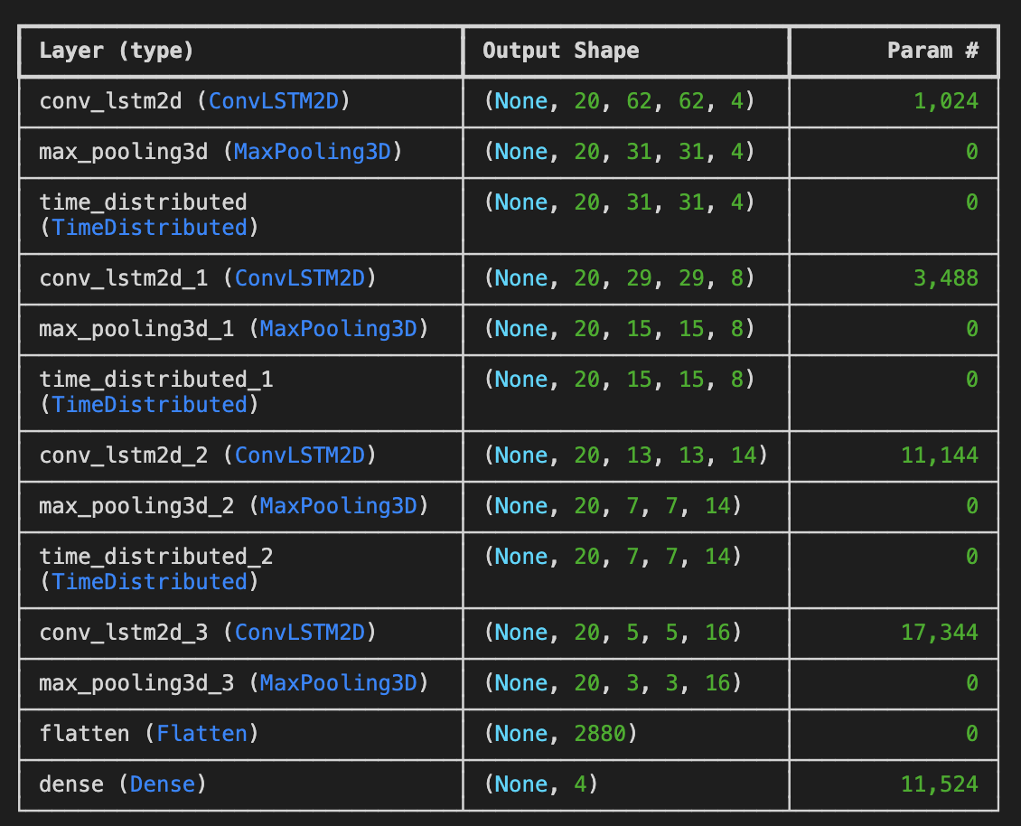
ConvLSTM model architecture Total params: 44,524 Trainable params: 44,524 Non-trainable params: 0
Notes:
In this model, we follow a sequential architecture built around ConvLSTM layers and some essential regularization and dimensionality reduction steps.
We begin with a ConvLSTM2D layer with 4 filters and a 3x3 kernel size, using tanh activation.
We set return_sequences=True to ensure that the temporal structure is preserved through this layer.
Next, we apply a MaxPooling3D layer with a pool size of 1x2x2 across time, height, and width.
This helps us reduce the spatial dimensions while retaining temporal consistency.
To prevent overfitting, we add a Dropout layer with a dropout rate of 0.2.
We follow that with a second ConvLSTM2D layer, this time increasing to 8 filters but keeping the kernel size at 3x3 and tanh activation.
Again, return_sequences=True is used to continue passing sequences forward.
After this, we apply another MaxPooling3D layer and Dropout, continuing to downsample the feature maps and regularize the model.
Then, we introduce a third ConvLSTM2D layer with 14 filters and a 3x3 kernel size.
This time, we set return_sequences=False since we now want to collapse the temporal dimension and extract the final encoded features.
The output from the last ConvLSTM layer is passed through a Flatten layer, which transforms the 3D feature map into a 1D vector, making it suitable for classification.
Finally, we conclude with a Dense output layer with 4 units, corresponding to our four target classes, and use a softmax activation to perform multi-class classification.

Slide 9
LRCN Pipeline
TimeDistributed Conv2D (frame‑level features).
MaxPooling + Flatten per frame.
LSTM (64 units) models temporal evolution.
Dense softmax classifier.
Modular: can swap in pretrained CNN backbones.
Notes:
The LRCN model separates things out:
First, spatial features are extracted frame-by-frame using Conv2D layers. Then, the sequence of features is fed to an LSTM to model how things change over time.
This modular design allows flexibility, and is great when individual frames already carry strong information.

Slide 10
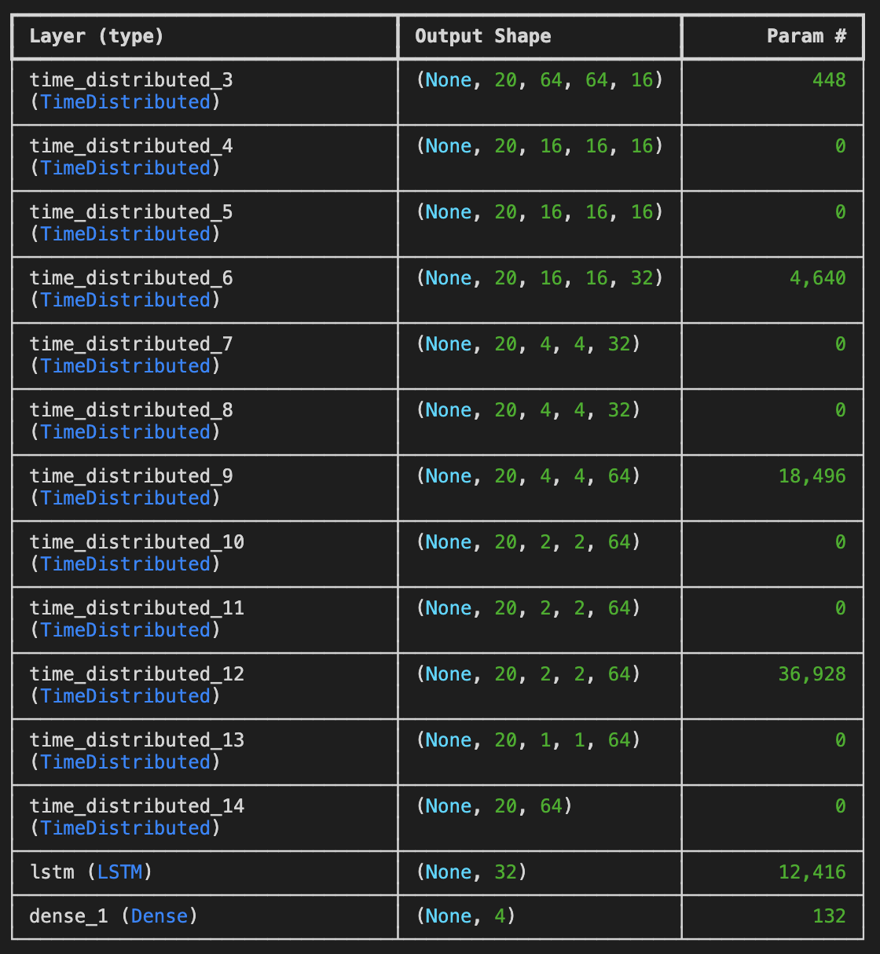
LRCN model architecture Total params: 73,060 Trainable params: 73,060 Non-trainable params: 0
Notes:
In this architecture, we use a combination of TimeDistributed layers and an LSTM to capture both spatial and temporal information:
We start with a TimeDistributed Conv2D layer having 32 filters and a 3x3 kernel size with ReLU activation.
This layer processes each frame independently, extracting spatial features from every frame.
After that, we apply a TimeDistributed MaxPooling2D layer with a 2x2 pool size, which reduces the spatial dimensions of each frame while keeping temporal information intact.
Next, we use a TimeDistributed Flatten layer to flatten each frame’s feature map into a vector, preparing the data for temporal modeling.
These flattened frame-wise vectors are then passed into an LSTM layer with 64 units, allowing the model to learn temporal dependencies across the sequence of frames.
Finally, the sequence output from the LSTM feeds into a Dense output layer with 4 units, one for each target class, using softmax activation for multi-class classification.

Slide 11
Training Setup
Loss: categorical cross‑entropy | Optimizer: Adam
Batch size: 4 | Epochs: ≤ 30 (early stopping, patience = 5)
Validation split: 20% | Fixed random seed: 27
GPU‑accelerated TensorFlow/Keras environment
Notes:
Both models were trained under identical conditions to ensure a fair comparison.
We used categorical cross-entropy loss and the Adam optimizer, trained in batches of 4, using early stopping to avoid overfitting.
GPU acceleration was used for faster training.

Slide 12
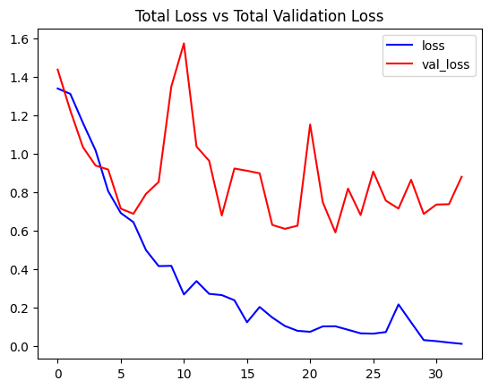
ConvLSTM Results
Notes:
This plot shows the training loss and validation loss across epochs.
The blue curve represents the training loss, and the red curve represents the validation loss.
We can see that the training loss consistently decreases, indicating that the model is learning and fitting the training data well.
However, the validation loss shows some fluctuations and does not decrease as smoothly.
This suggests that while the model is learning on the training set, it struggles a bit to generalize to the unseen validation data — a typical early sign of overfitting.
Overall, the training loss reaching near-zero is a good indicator of successful optimization, but the gap between training and validation loss signals that further regularization or more data could help improve generalization.

Slide 13
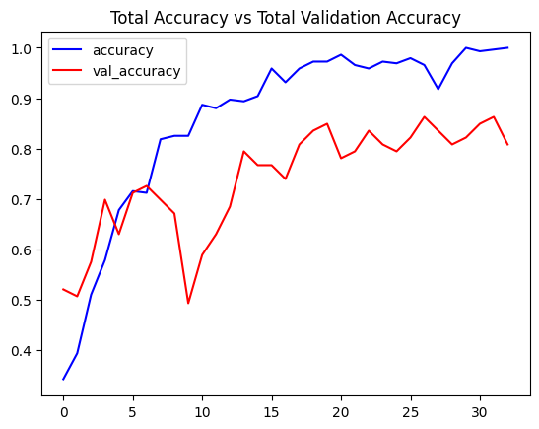
ConvLSTM Results
Notes:
This plot shows the training accuracy and validation accuracy over epochs.
The blue curve shows training accuracy, and the red curve shows validation accuracy.
We observe that training accuracy improves steadily and eventually approaches almost 100%, suggesting that the model is learning the training examples very well.
The validation accuracy also increases initially but fluctuates after a certain point and stabilizes at a lower value compared to training.
The gap between the two accuracies reinforces the earlier observation of overfitting — the model is memorizing training examples better than it is generalizing to unseen data.
Despite this, the validation accuracy still stays reasonably high, indicating that the model is still performing quite well overall.

Slide 14
ConvLSTM – Results
Test Accuracy: 79.25 %
Test Loss: 0.5773
Strengths: excels on fluid motion (WalkingWithDog, HorseRace).
Limitations: confusion between visually similar motions (Swing vs TaiChi).
Notes:
Our ConvLSTM model achieved about 79% test accuracy.
It performed very well on fluid motion activities like WalkingWithDog and HorseRace. But, we noticed some confusion when motions looked visually similar, like between Swing and TaiChi.

Slide 15
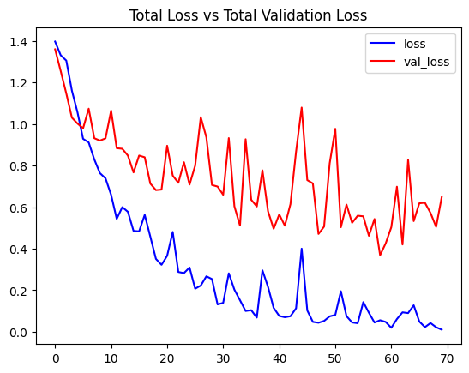
LRCN Results
Notes:
This plot shows how the training loss (blue) and validation loss (red) evolved over 70 epochs.
The training loss decreases steadily over time, which indicates that the model is consistently learning from the training data.
The validation loss, although more noisy and fluctuating, shows a general downward trend initially but stabilizes after a certain point.
The persistent gap between training and validation loss hints that the model is starting to overfit after some epochs.
The training loss keeps dropping, but the validation loss stops improving much.
Despite the fluctuations, the fact that the validation loss does not increase drastically shows that the model retains decent generalization capability, though there is room for improvement, possibly through additional regularization techniques like early stopping or dropout tuning.

Slide 16
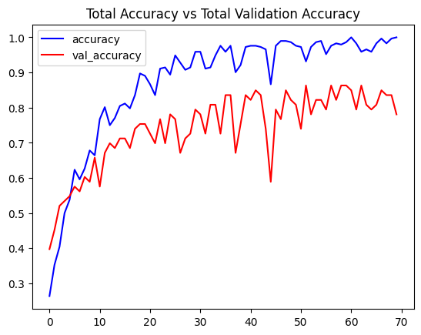
LRCN Results
Notes:
This plot shows training accuracy (blue) and validation accuracy (red) over the epochs.
The training accuracy improves consistently and reaches almost 100%, suggesting that the model fits the training data extremely well.
The validation accuracy also improves sharply in the beginning, and although it fluctuates, it stabilizes around 80–85%, which is a strong performance on unseen validation data.
The gap between training and validation accuracy again points towards overfitting — the model is excellent on training data but somewhat less confident on validation data.
Nonetheless, achieving and maintaining above 80% validation accuracy for a video classification task like this shows that the model has learned meaningful temporal and spatial features.

Slide 17

LRCN – Results
Test Accuracy: 86.93 %
Test Loss: 0.2854
Strengths: leverages strong frame‑level spatial cues.
Very few misclassifications observed.
Notes:
The LRCN model performed even better — achieving almost 87% test accuracy.
By explicitly separating spatial and temporal processing, it minimized misclassifications and showed stronger generalization.
This highlights how modeling choices affect performance.

Slide 18
ConvLSTM vs LRCN
Overall Accuracy: 79 % vs 87 %
LRCN lower loss; better generalization.
ConvLSTM better at continuous motion; LRCN excels with salient frames.
Both models stable in training (early stopping).
Notes:
Here’s a side-by-side comparison:
LRCN beats ConvLSTM both in accuracy and stability.
While ConvLSTM is better for activities with strong temporal continuity, LRCN is better for activities where individual frames are highly informative.
Choosing the right model really depends on the nature of the activity.

Slide 19
Integration with HMM/DBN Pipeline
Recognized activities feed as observations to HMM/DBN for movement forecasting.
Creates proactive smart‑home automation loop.
Demonstrates synergy between deep vision models and probabilistic predictors.
Notes:
Importantly, this isn’t just about video classification. We’re feeding these activity recognitions into probabilistic models — HMMs and DBNs — to predict what users might do next in smart homes. This enables proactive decision-making — imagine lights turning on before you even enter the room!

Slide 20
Key Takeaways
Deep spatiotemporal models achieve strong HAR on UCF50 subset.
LRCN outperforms ConvLSTM under identical training regime.
Findings guide model selection for real‑time HAR applications.
Notes:
To sum up: Deep spatiotemporal models are very effective for HAR tasks. LRCN offered superior performance under our setup, but both models provided valuable insights. This work lays a foundation for building intelligent systems that not only recognize but also predict human activities.

Slide 21
Future Directions
Scale to full 50‑class UCF50 or larger datasets (UCF101, HMDB51).
Data augmentation & longer frame sequences.
Incorporate pretrained CNNs and attention/Transformer blocks.
Edge deployment via model compression (TensorFlow Lite).
Notes:
Going forward, we plan to: Scale up to all 50 classes in UCF50, try data augmentation, test longer sequences, incorporate pretrained models like ResNet, and explore Transformer-based architectures.

Slide 22
References
Donahue et al., 2015 – Long‑term Recurrent Convolutional Networks.
Shi et al., 2015 – ConvLSTM for precipitation nowcasting.
Tran et al., 2015 – 3D CNNs for spatiotemporal learning.
Simonyan & Zisserman, 2014 – Two‑stream CNNs.
Soomro et al., 2012 – UCF50 dataset introduction.
Notes:
And lastly, here are the key papers and datasets that guided this project. If you’re interested in learning more about ConvLSTM, LRCN, or 3D CNNs, these are great starting points.

Slide 23

Thank You

